Slide 1








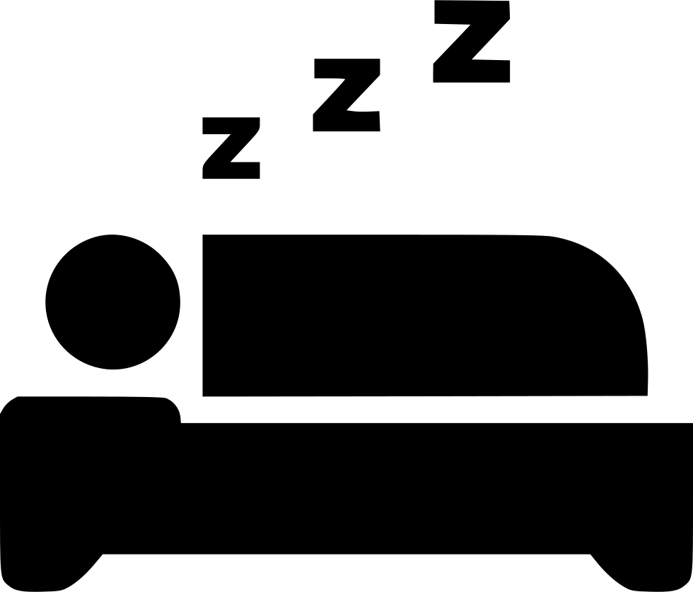
Analyzing Personal Health Data
Robert Swanson

Slide 2
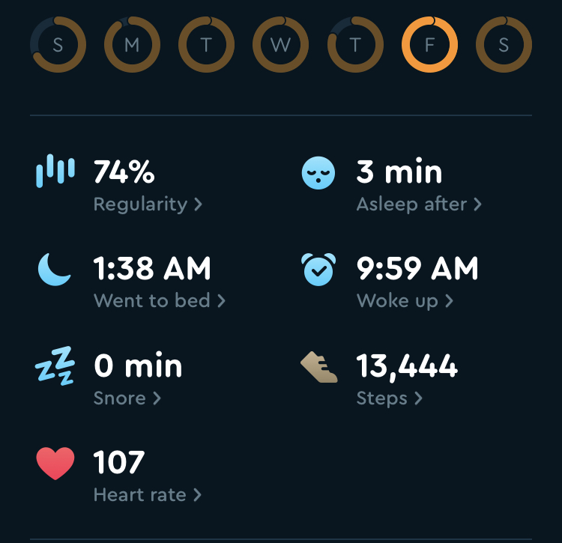
The Question:
What factors influence sleeping heart rate?

Slide 3
Available Data (Collected from my iPhone and Apple Watch)
Sleep Analysis (minutes in bed, asleep)
Heart Rate
Active Calories
Resting Calories
Cycling Distance
Distance
Steps
Flights of Stairs Climbed

Slide 4
Step 1: Clean Up and Manipulate
Used readr, dplyr, lubridate, matrixStats libraries

Slide 5
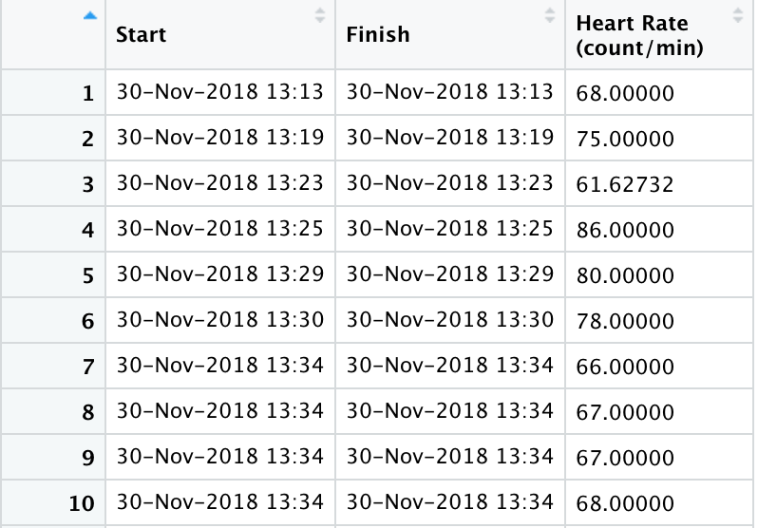
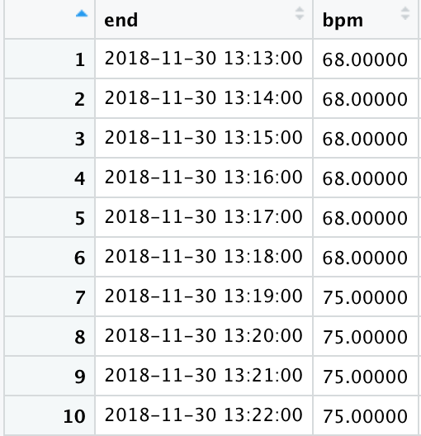
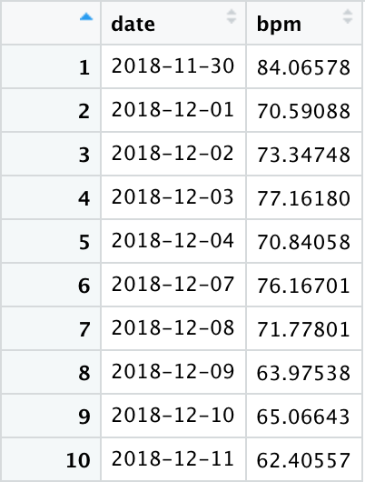
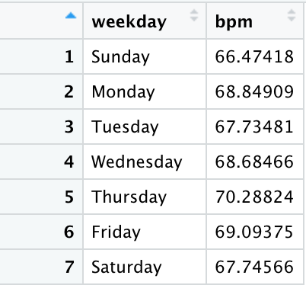
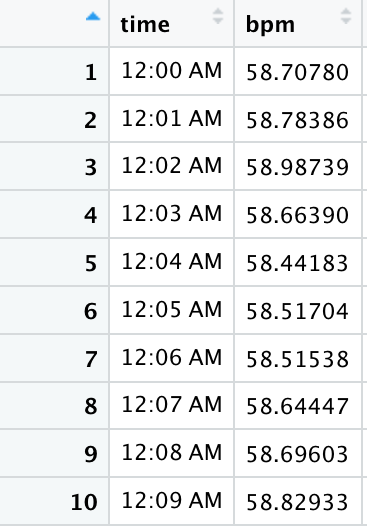
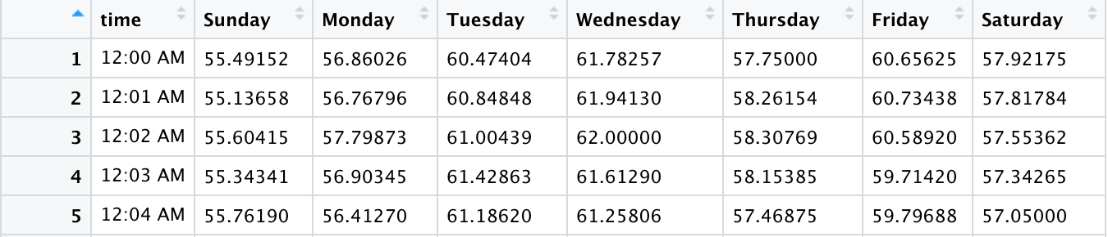
Joined to full minute table
*Any Data Points fulfilling over 10 minutes are invalidated (NA)
Filled Down
Averaged
Mean
Median
Max
Min
Raw Data
Grouped by datetime
pivot_wider(names_from = weekday, values_from = bpm)
Grouped by date
Grouped by weekday
Grouped by time
Grouped by weekday and time

Slide 6
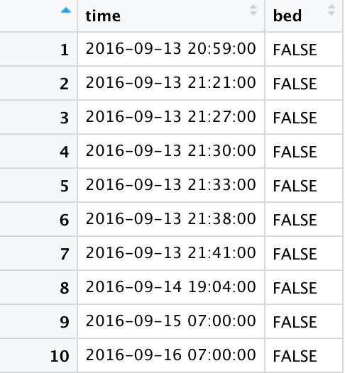
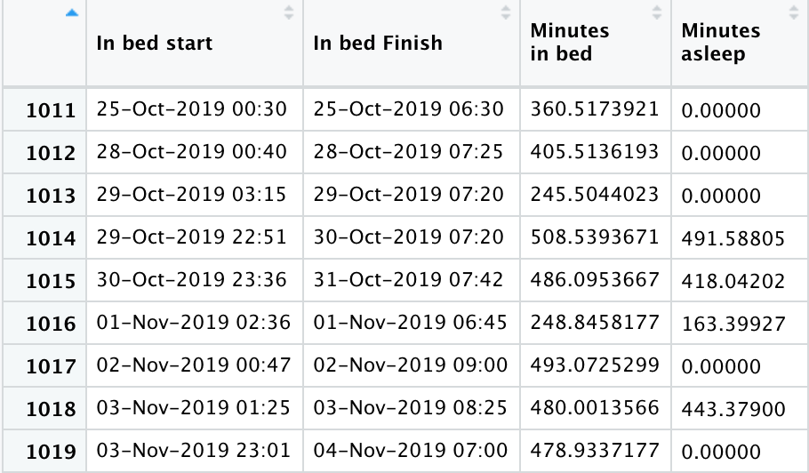
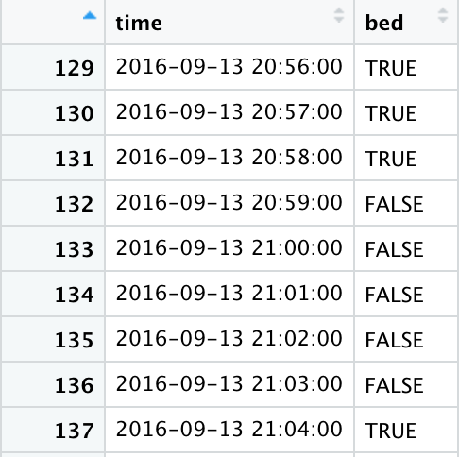
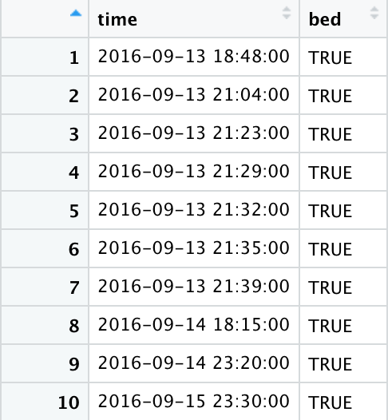
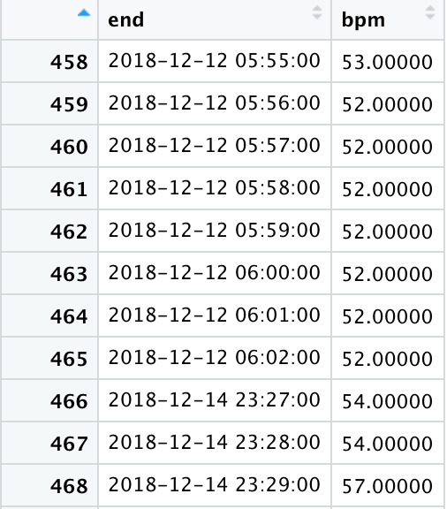
Filled Down
End Times
Raw Data
Datetime is in bed
Inner Join
Start Times
Heart Rate Grouped by datetime
Bed Heart Rate Grouped by:
Datetime
Date
Weekday
Bed Heart Rate

Slide 7
Step 2: Visualize and Understand
Used ggplot and googleVis libraries

Slide 8
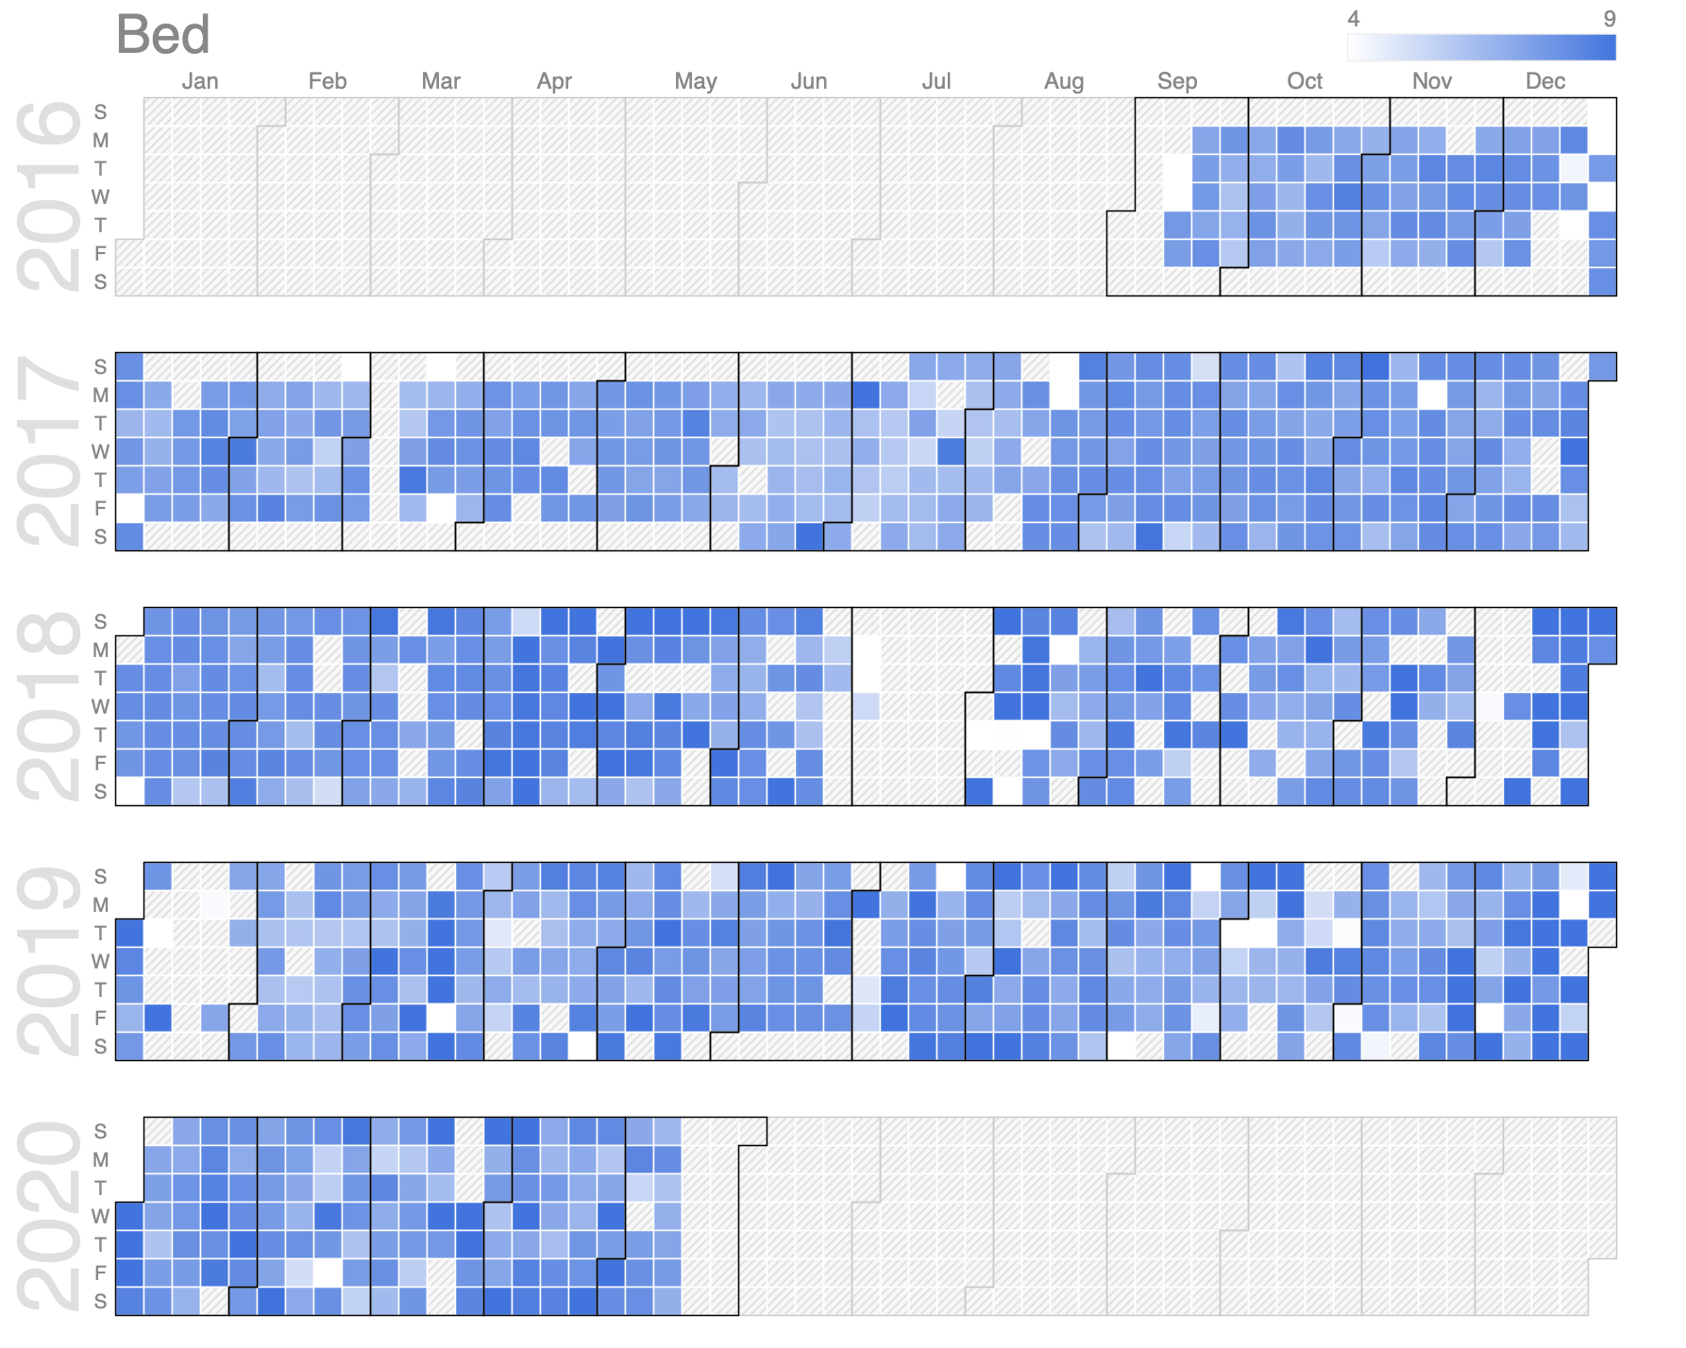
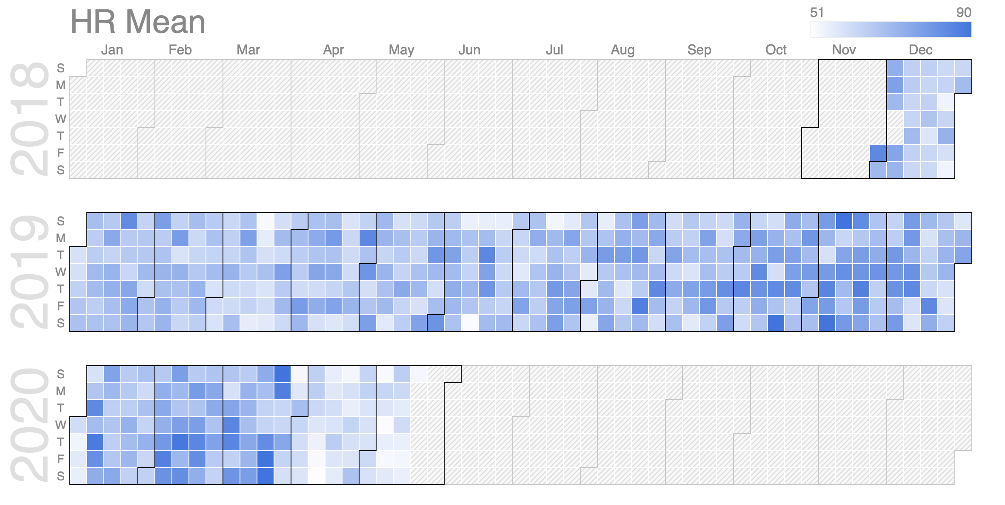
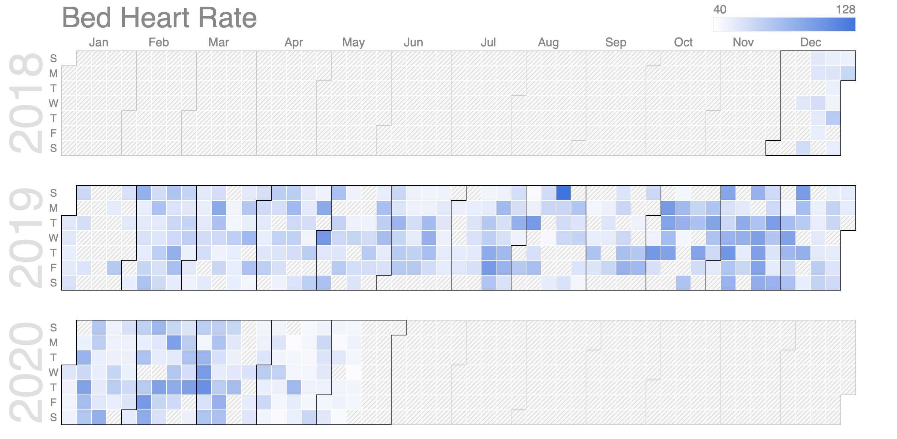
Year Plots (googleVis)

Slide 9
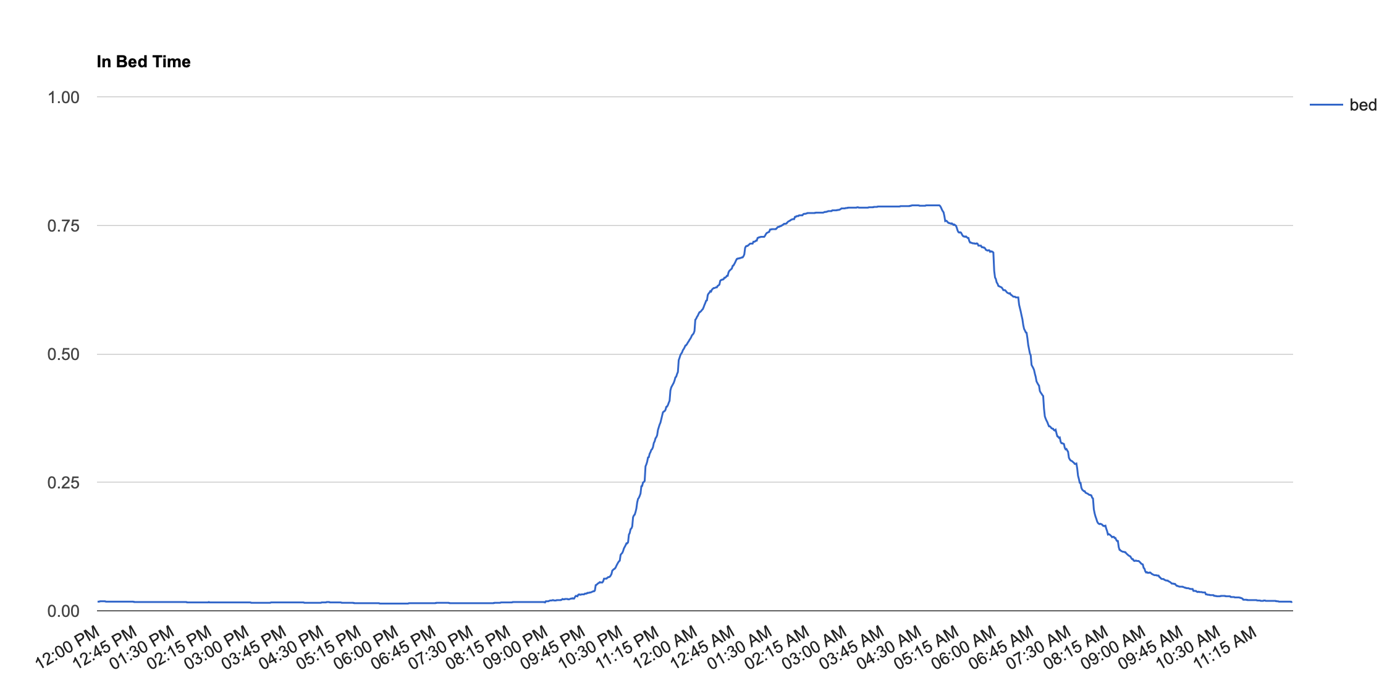
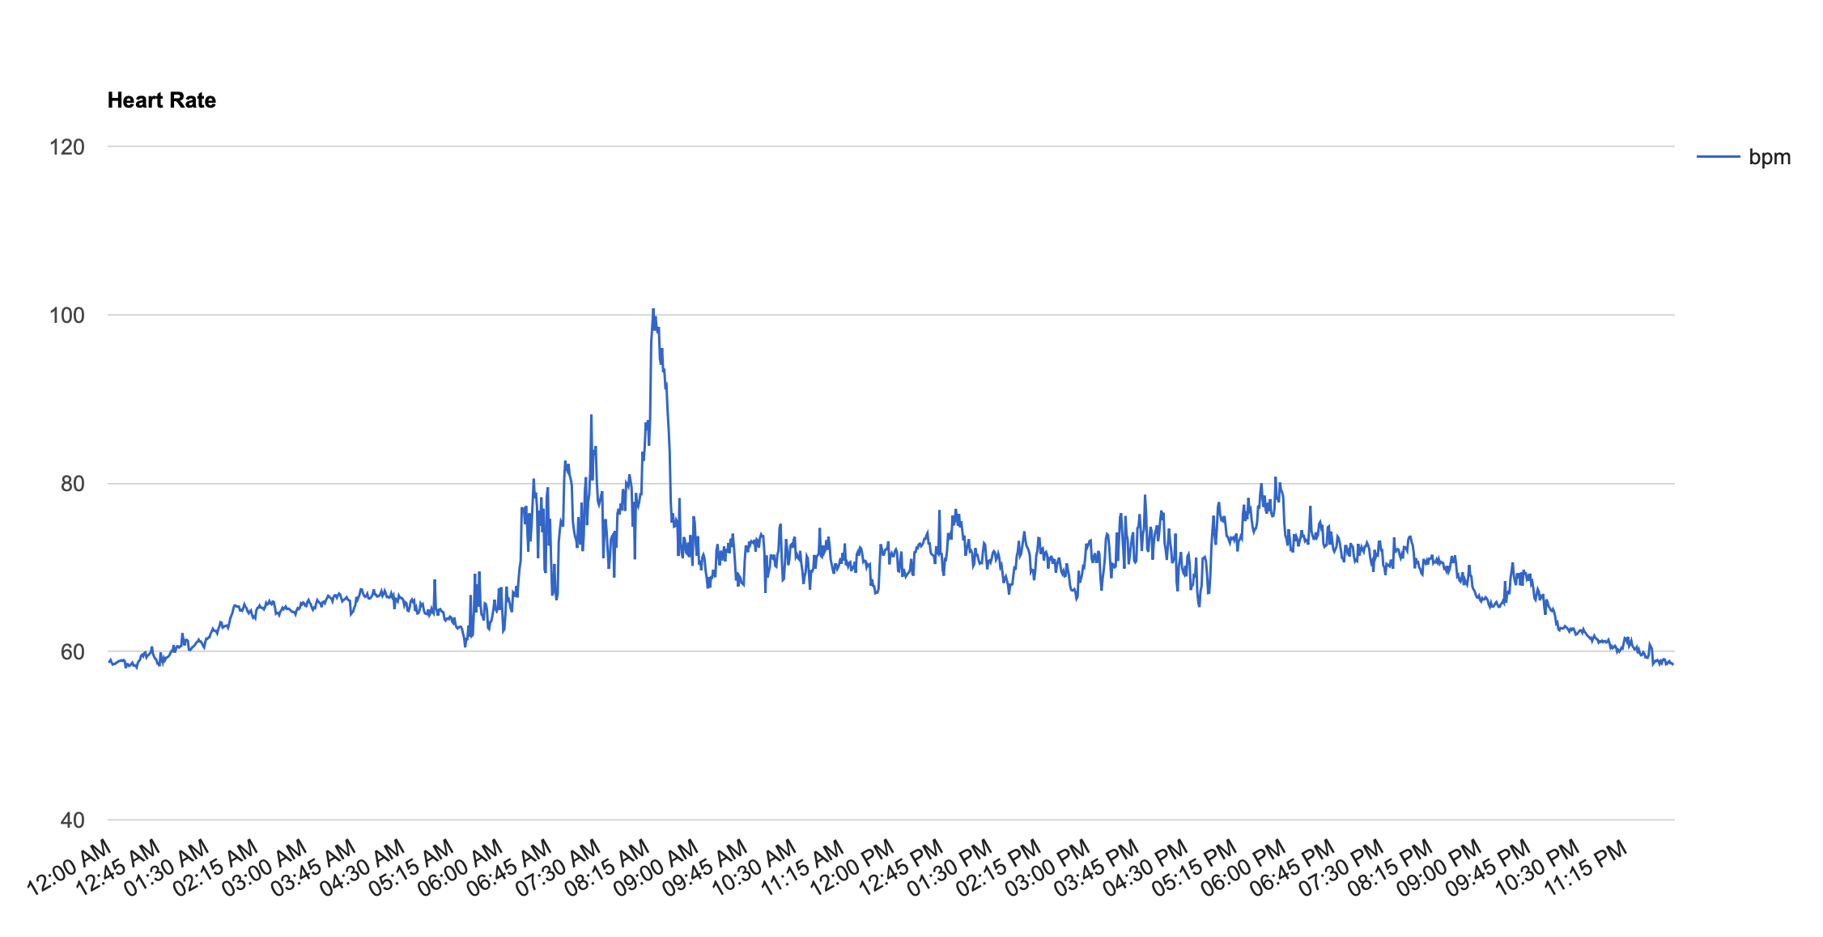
Line Plots (googleVis)

Slide 10
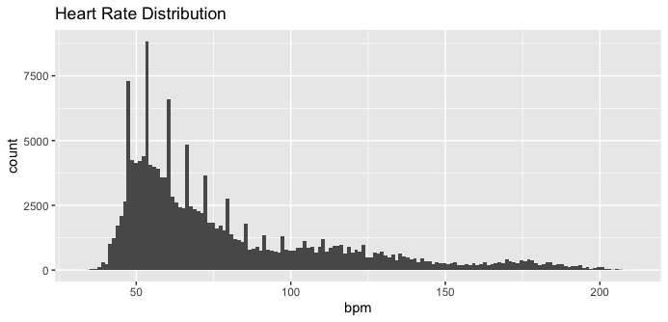
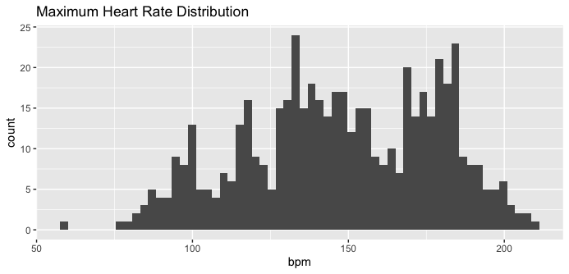
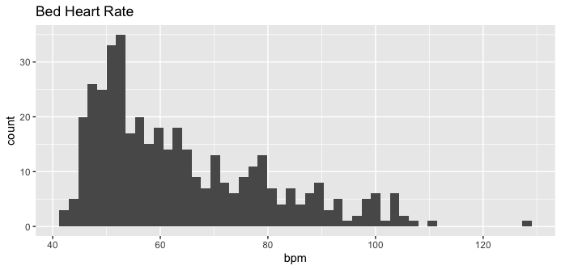
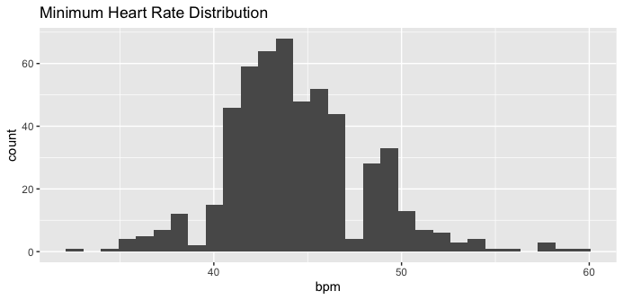
Distribution Histograms

Slide 11
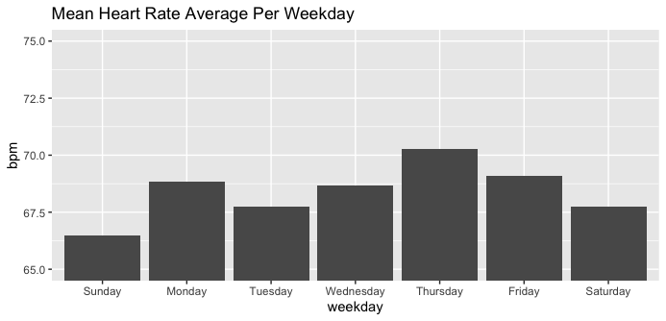
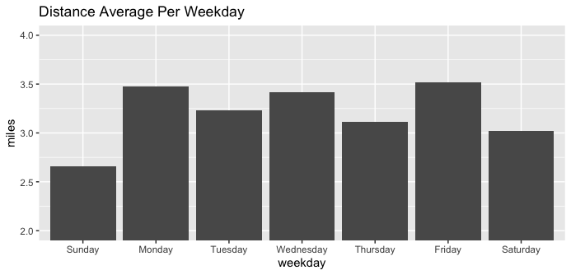
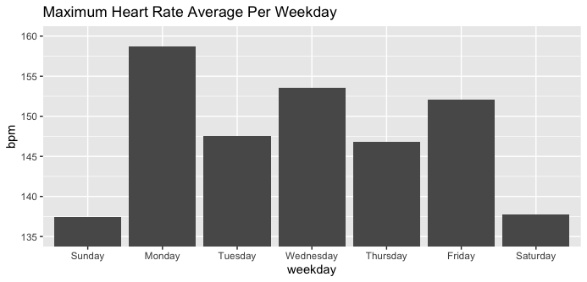
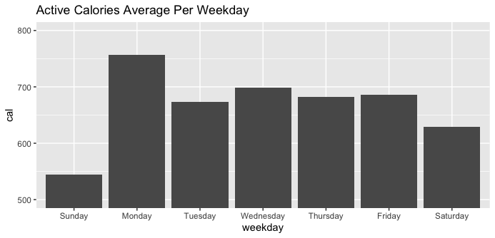
Weekday Charts

Slide 12
Step 3: Correlate and Analyze
Used zoo and rpart libraries

Slide 13
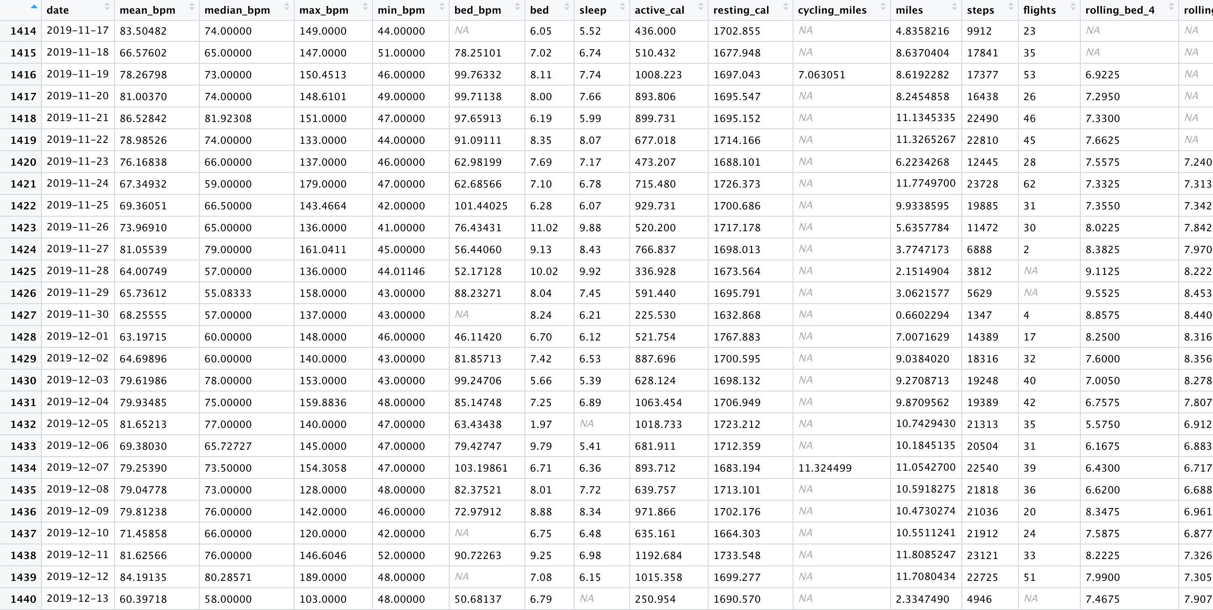
Unify into single Calendar
zoo:rollmean()

Slide 14
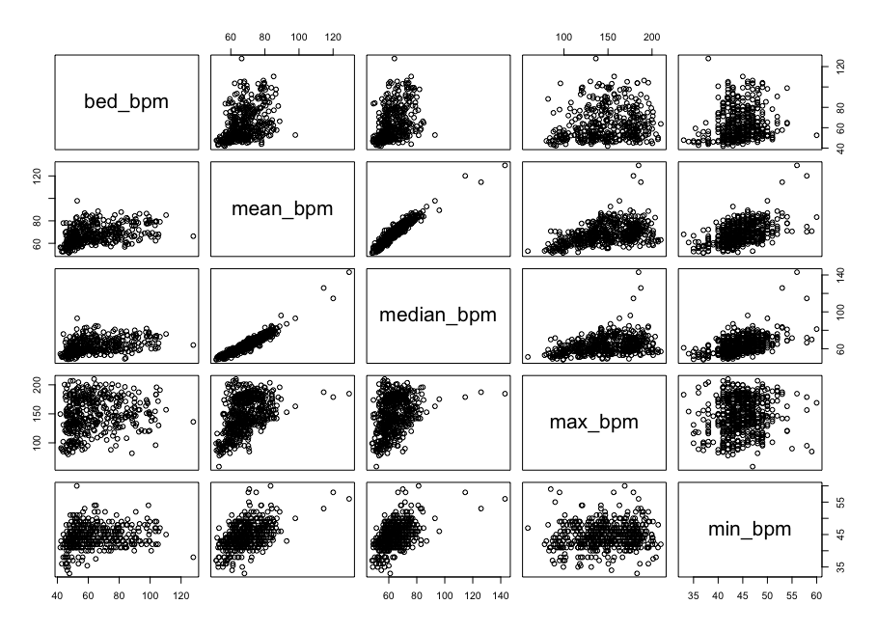
Heart Correlation

Slide 15
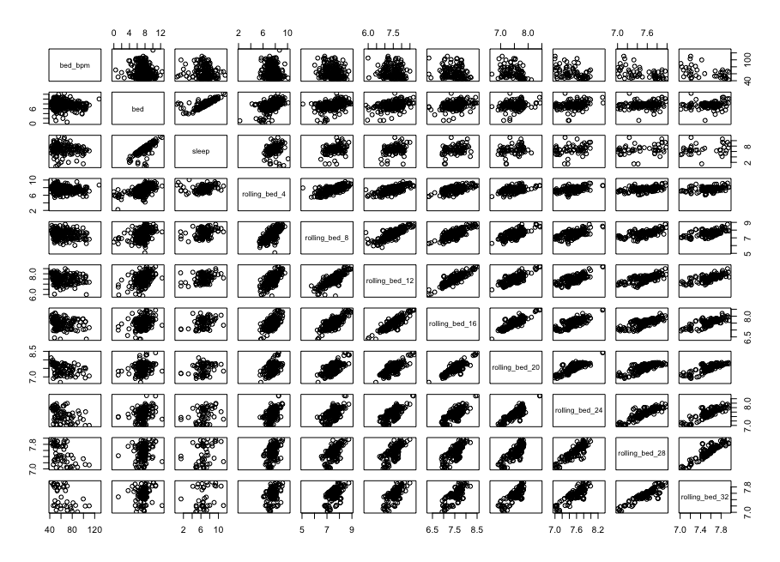
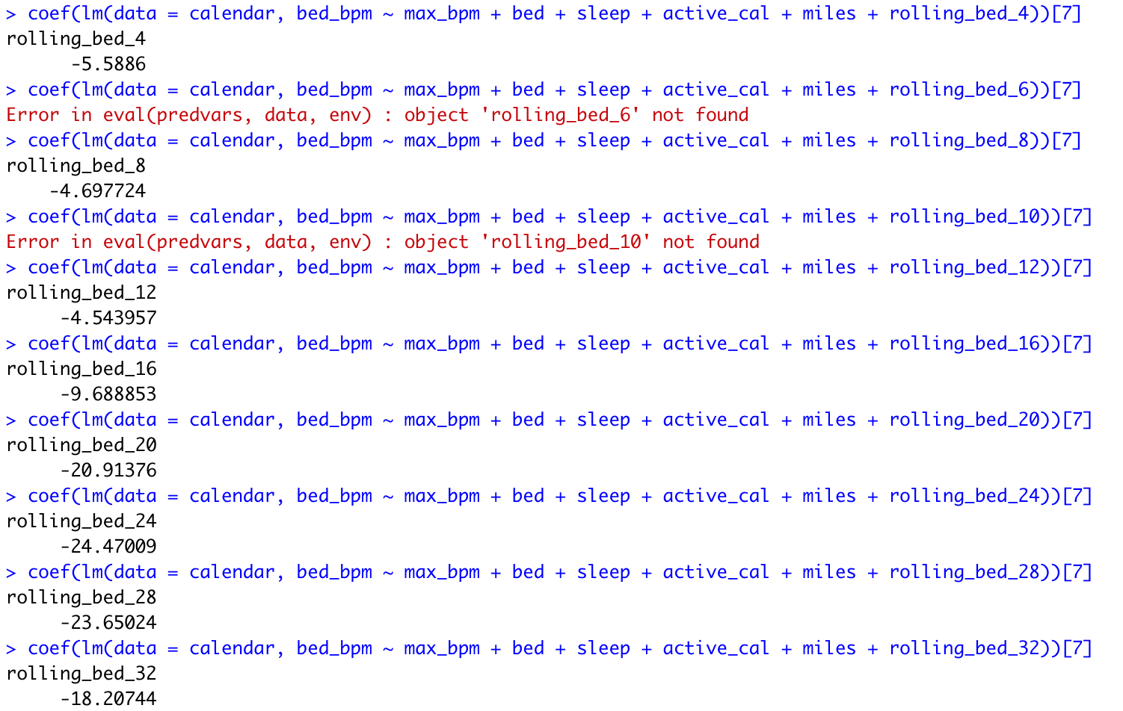
Sleep Correlation

Slide 16
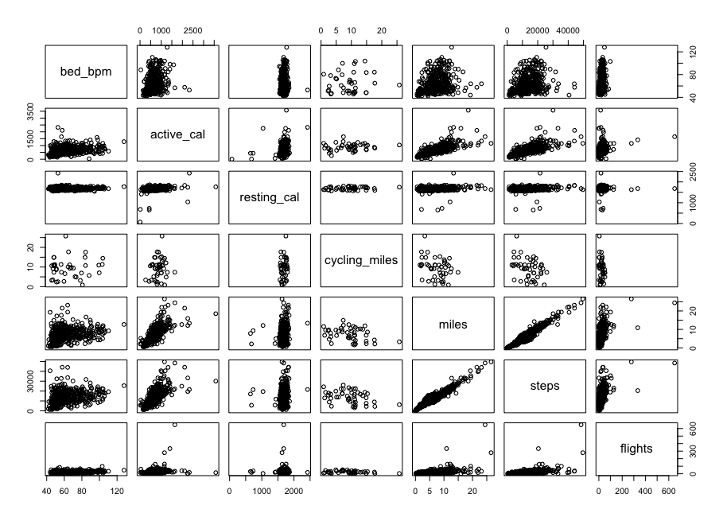
Activity Correlation

Slide 17
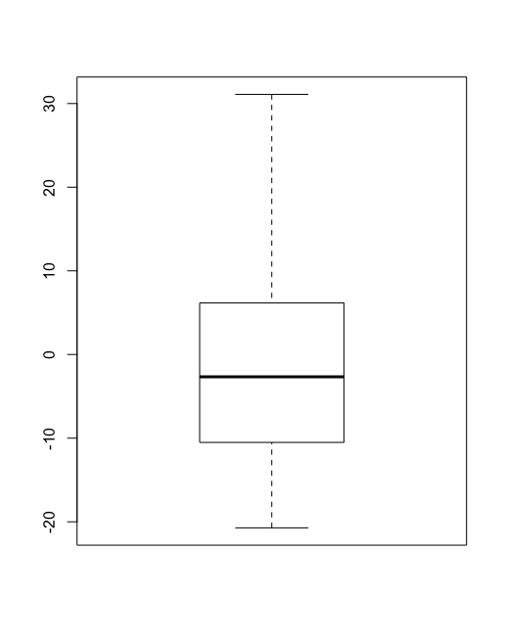
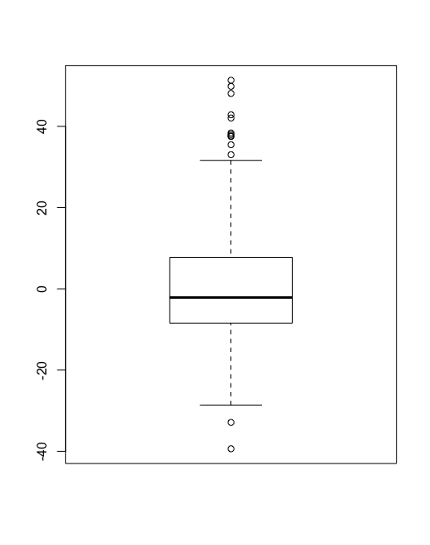
Build the models
> formula <- bed_bpm ~ max_bpm + bed + sleep + active_cal + miles + rolling_bed_24
> lin_reg_model <- lm(data = calendar_train , formula)
> desc_tree_model <- rpart(formula, calendar_train)
> coef(lin_reg_model)
(Intercept) max_bpm bed sleep active_cal miles rolling_bed_24
188.671445426 0.062080412 9.705837409 -8.544298012 0.009507391 0.119297898 -20.795441859
Distribution of linear regression model
Distribution of decision tree model

Slide 18
